Slide 1
Job Portal Website
Marwadi University
Yamunesh Patadia – 92200584028
Company Name – MNS Technologies - Rajkot
Internal Guide – Dr. Kalpesh Popat
External Guide – Mrs. Heena Trivedi

Slide 2
Synopsis
The “Job Portal” provides a comprehensive guide to understanding and utilizing a sophisticated online job portal built using Laravel/PHP with MySQL database. This documentation serves as a roadmap for users, companies, and administrators, offering insights into the website's features, architecture, and functionalities.
INTRODUCTION
The introduction outlines the purpose and objectives of the project, targeting a broad audience interested in exploring or utilizing the job portal website.

Slide 3
FEATURES
This section delves into the various features offered by the job portal website, categorizing them based on user roles (User, Company, Admin). It describes how users can browse job listings, apply for jobs, and interact with posts and other users.
Architecture and Technologies Used:
The architecture section provides insights into the underlying technology stack, including Laravel/PHP framework and MySQL database.
The “Job Portal” serves as a comprehensive resource for understanding, utilizing, and further developing the job portal website, catering to the diverse needs of users, companies, and administrators alike.

Slide 4
PREAMBLE
General Introduction
The Job Portal is a platform that connects job seekers with potential employers. The website offers a range of features for users, companies, and administrators, and is built using Laravel/PHP with a MySQL database.
Statement of Problem
Finding a job or hiring the right candidate can be a challenging and time-consuming process. Job seekers often struggle to find relevant job opportunities, while employers struggle to find qualified candidates.

Slide 5
Objective and Scope of the Study
Providing users with a user-friendly interface for browsing job listings, applying for jobs, and interacting with other users.
Empowering companies to post job openings, manage their profiles, and engage with potential candidates.
Equipping administrators with tools for managing users, verifying companies, and overseeing job postings.

Slide 6
Module Description with functionality
User Module: Enables users to browse job listings, apply for jobs, save job listings, follow other users and companies, post content, and engage with posts through comments and likes.
Company Module: Empowers companies to post job openings, manage their company profiles, view user interactions, and engage with potential candidates.
Admin Module: Provides administrators with tools for managing users, verifying companies, moderating content, and overseeing the overall functionality of the website.

Slide 7
Methodology
The development of the Job Portal Website follows an iterative and collaborative approach, leveraging the Agile methodology.
Feasibility Study
A feasibility study was conducted to assess the viability of this project. The study considered technical, economic, and operational factors. The chosen technologies (Laravel/PHP, MySQL) are widely used and well-supported, making the project technically feasible.

Slide 8
REVIEW OF LITERATURE
Evolution of Online Job Portals
From basic job listings to advanced platforms offering personalized recommendations and social networking integration.
User Experience in Job Portals
Emphasizes the importance of intuitive interfaces and personalized features to enhance user satisfaction and engagement.

Slide 9
Role of Social Media in Recruitment
Highlights the impact of social media platforms in sourcing talent and building employer branding.
Technology Trends
Explores advancements in AI, machine learning, and NLP for automating recruitment processes and improving efficiency.
Emerging Trends
Discusses the integration of VR, blockchain, and gig economy platforms as emerging trends shaping the future of online job portals

Slide 10
TECHNICAL DESCRIPTION
Hardware Requirement
The hardware requirements for this website are relatively modest and can vary depending on the expected user traffic. Here’s a general guideline:
Processor: Intel Pentium IV or equivalent (multi-core processor recommended for higher traffic)
RAM: 4 GB minimum (8 GB or more recommended for optimal performance)
Hard Disk Space: 50 GB minimum (additional space needed for data storage as the website grows)
Internet Connection: Reliable internet connection with good bandwidth

Slide 11
Software Requirement
The website's functionality relies on the following software components:
Web Server: Apache, Nginx, or any other compatible web server software.
PHP: Version 7.4 or higher (check your web hosting provider's supported versions).
MySQL Database: Version 5.6 or higher to store website data.
Laravel Framework: Version 8 or higher for efficient web application development.
Composer: Dependency management tool for PHP (used to install Laravel and other required packages).

Slide 12
SYSTEM DESIGN AND DEVELOPMENT
Architectural Design / System Flow
The Job Portal Website follows a layered architectural design, leveraging the Model-View-Controller (MVC) architecture provided by the Laravel PHP framework.
Client-Side Interaction:
Users, companies, and administrators interact with the website through their respective user interfaces, accessing various features and functionalities.
Server-Side Processing:
Requests from clients are routed to the appropriate controllers within the Laravel application.

Slide 13
Data Storage and Retrieval
Data is stored and managed in the MySQL database, following the defined database schema.
Presentation Layer
Views in Laravel are responsible for rendering HTML content to be displayed to users.
Routing and Middleware
Laravel's routing mechanism maps incoming requests to corresponding controller actions based on defined routes.

Slide 14
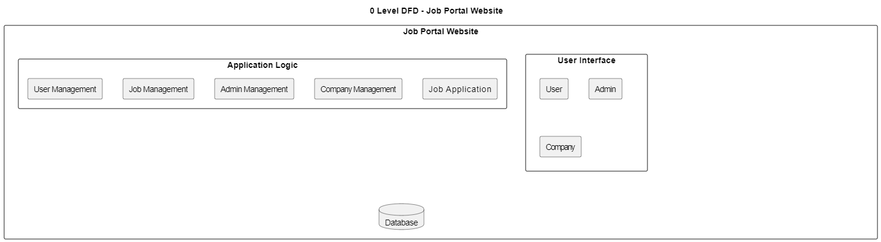
0 Level Data Flow Diagram

Slide 15
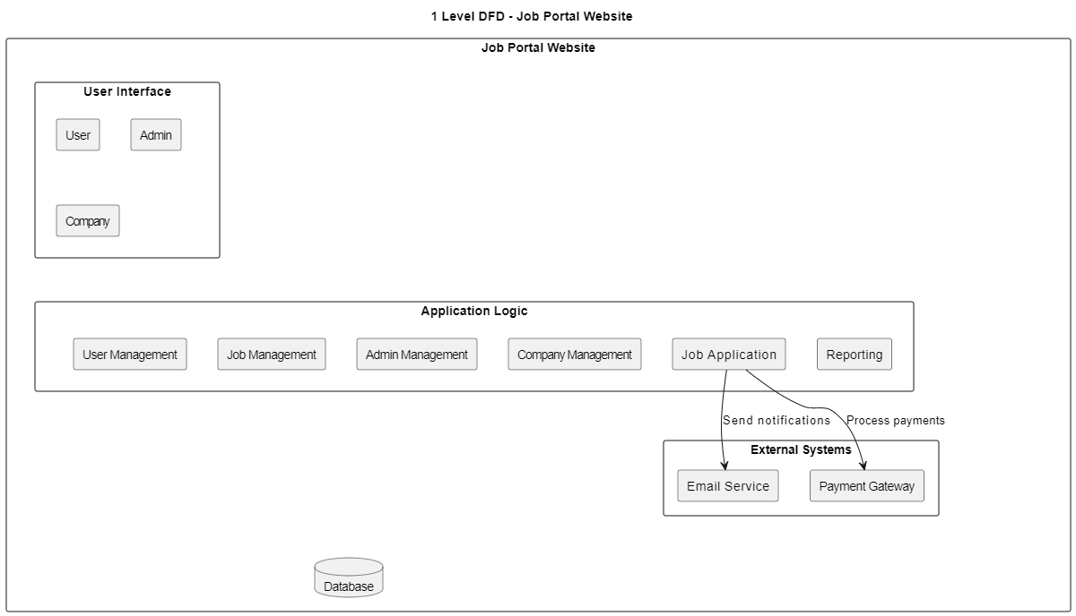
1 Level Data Flow Diagram

Slide 16
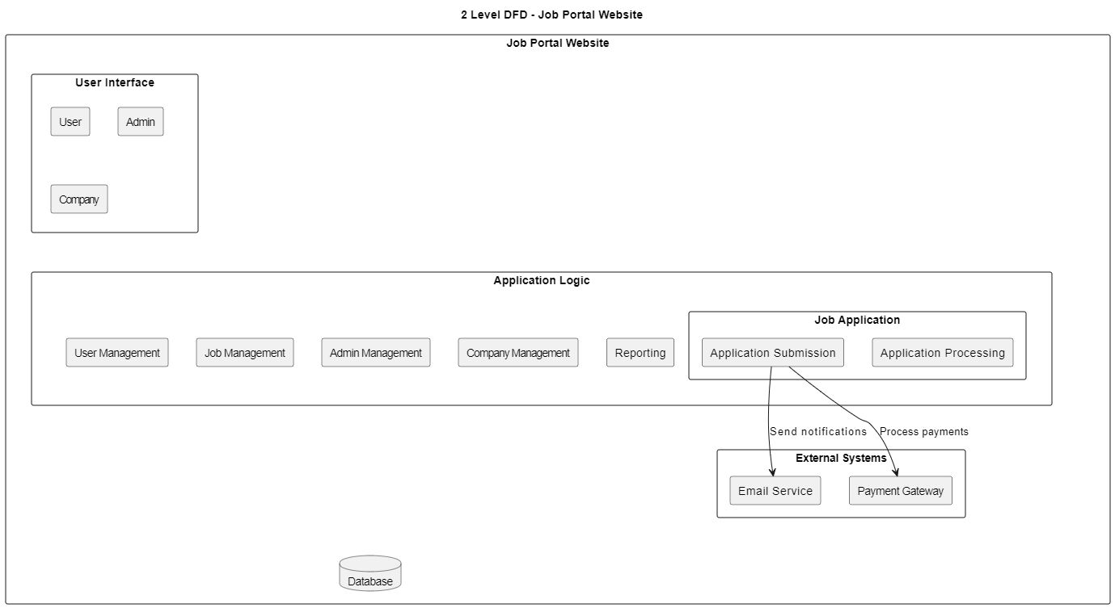
2 Level Data Flow Diagram

Slide 17
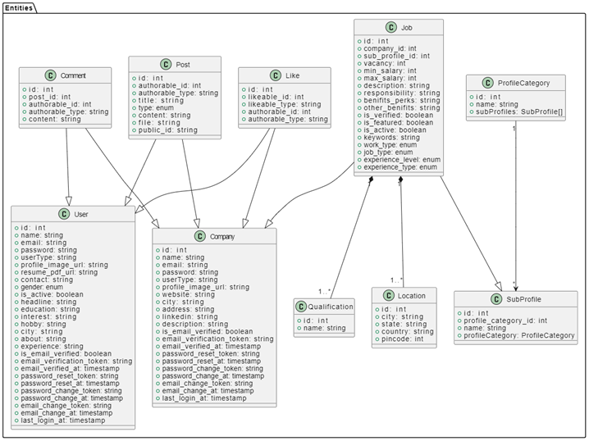
Class Diagram

Slide 18
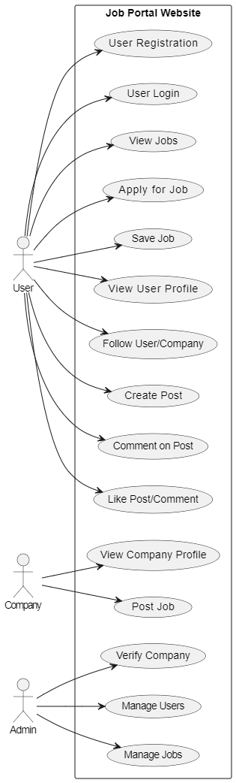
Use Case Diagram

Slide 19
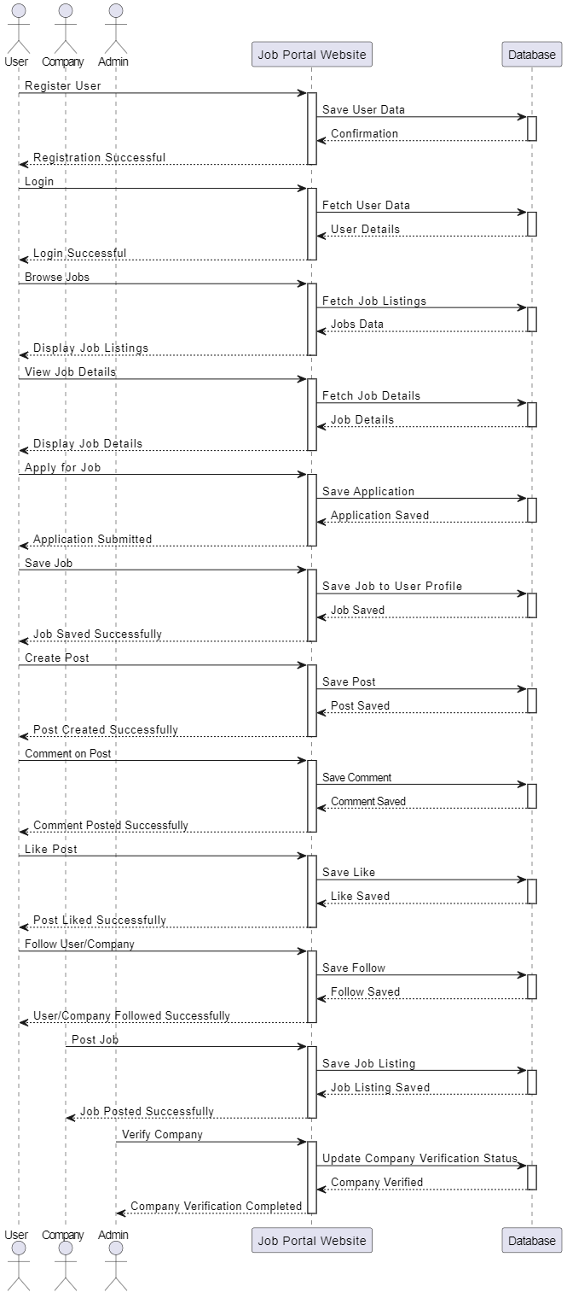
Sequence Diagram

Slide 20
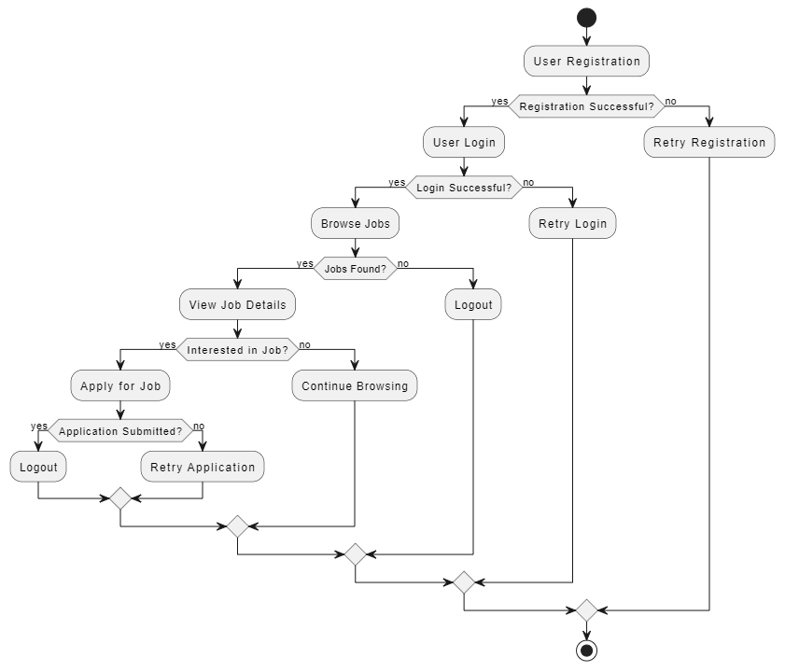
Activity Diagram

Slide 21
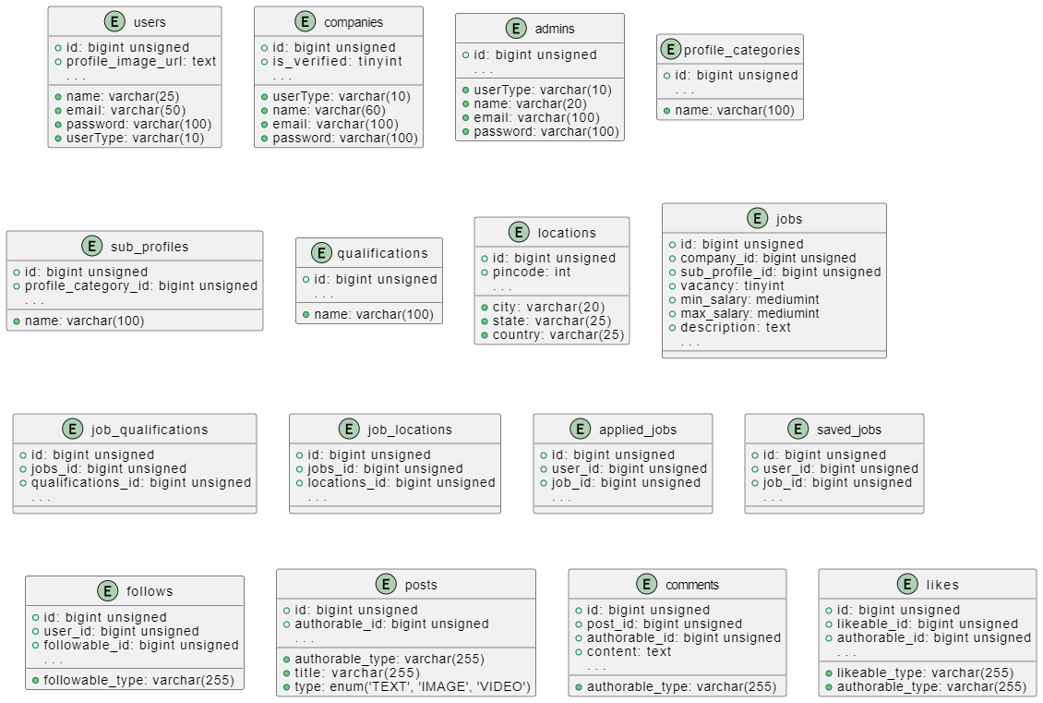
Table Structure

Slide 22
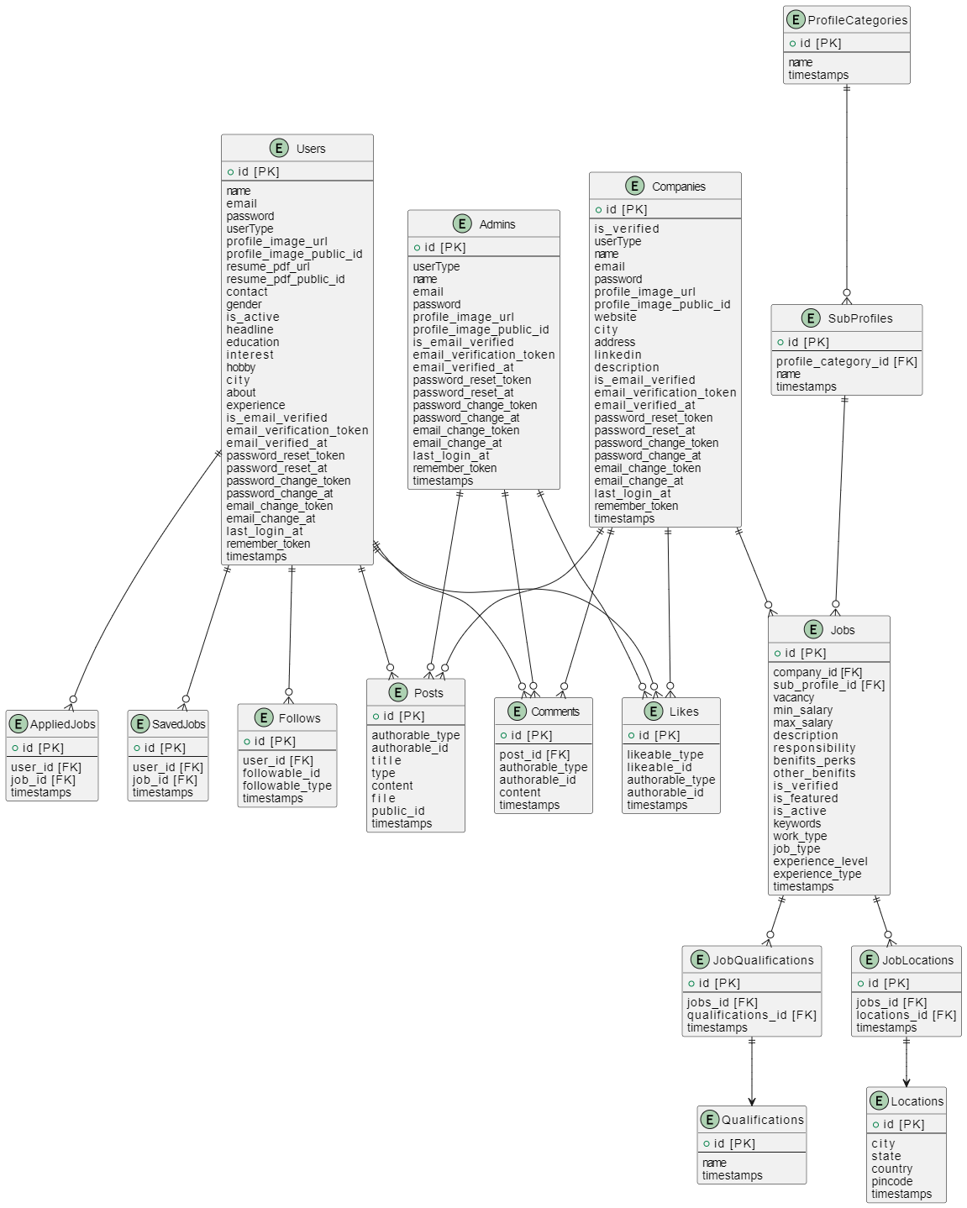
Entity Relationship Diagram

Slide 23
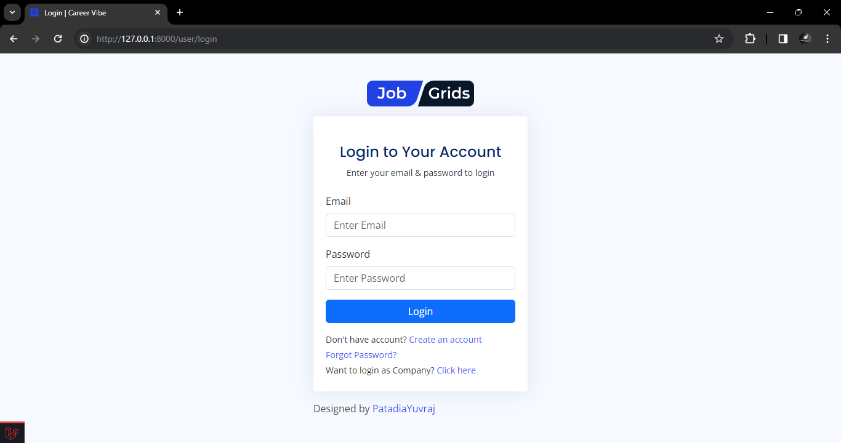
Screen Shots

Slide 24
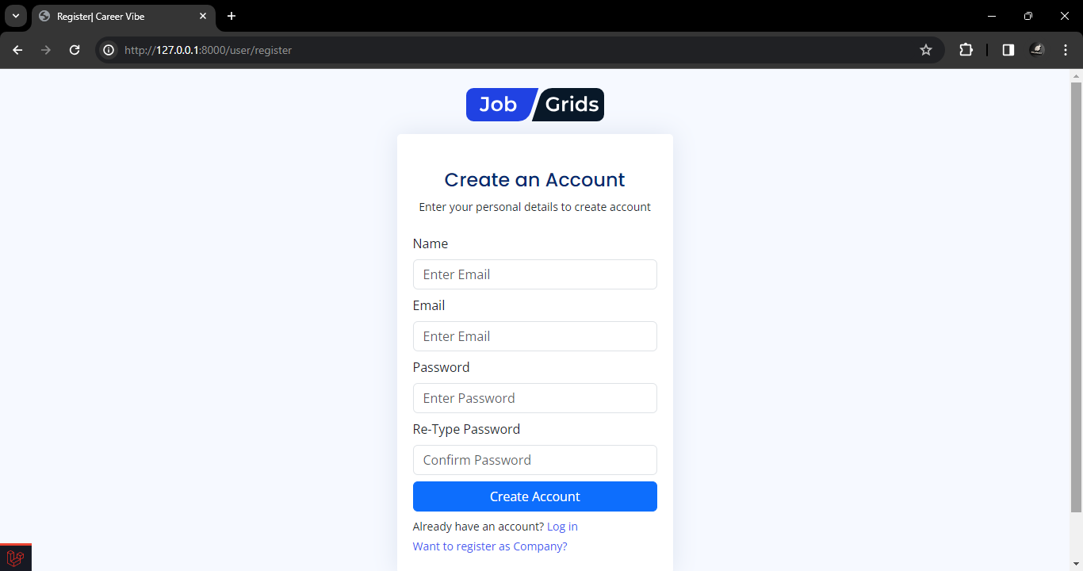
Screen Shots

Slide 25
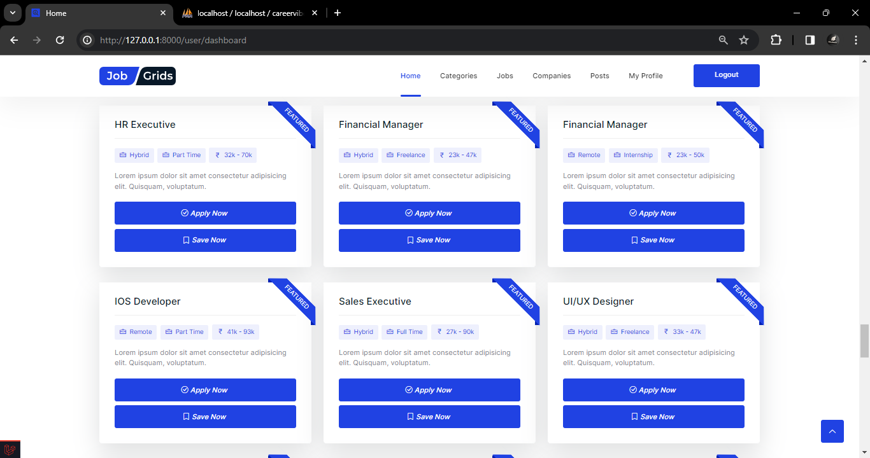
Screen Shots

Slide 26
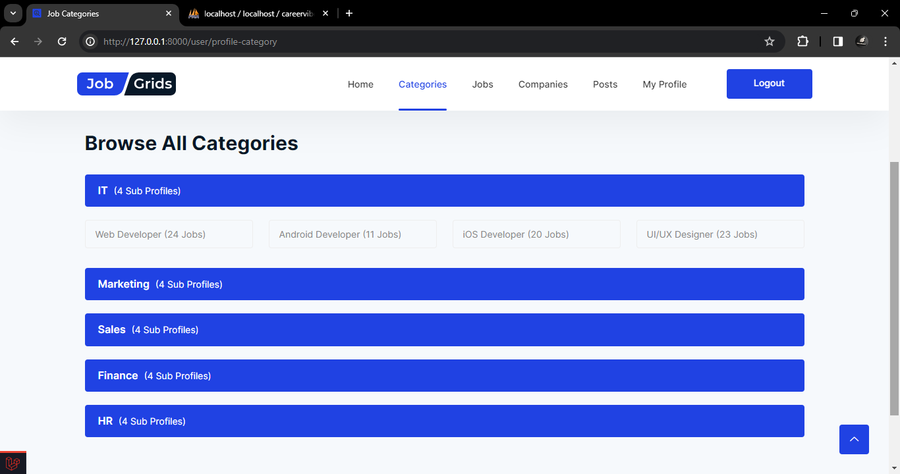
Screen Shots

Slide 27
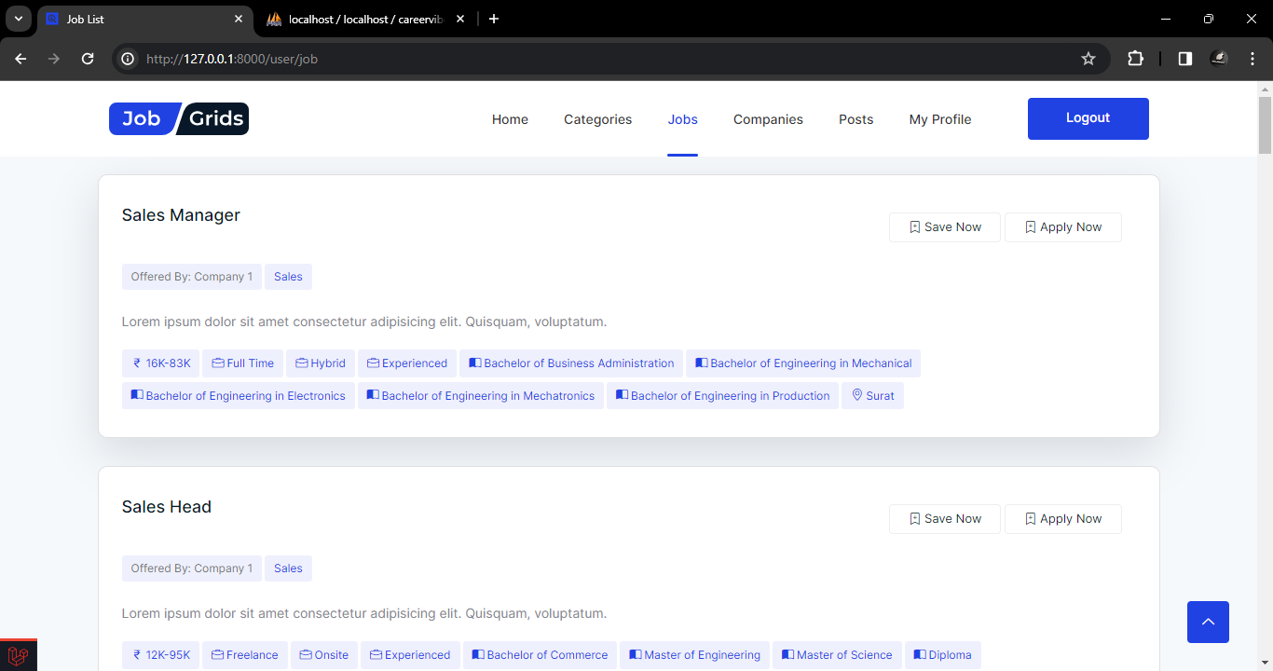
Screen Shots

Slide 28
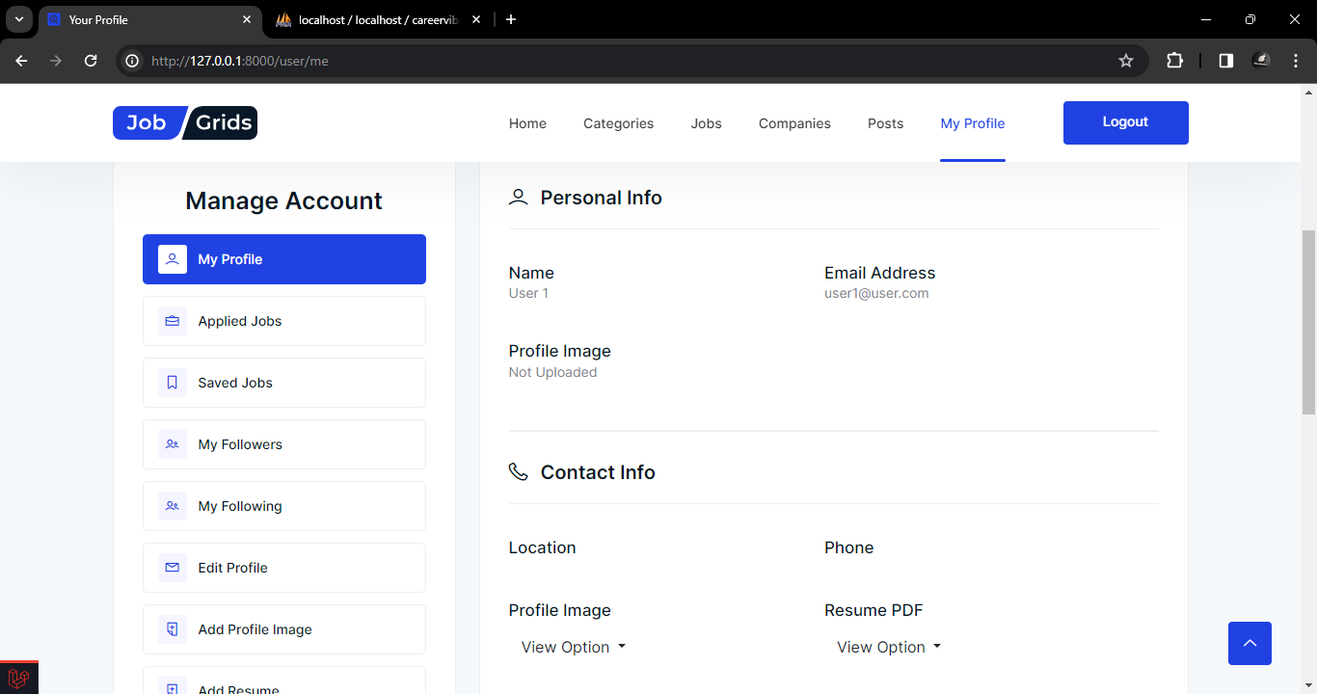
Screen Shots

Slide 29
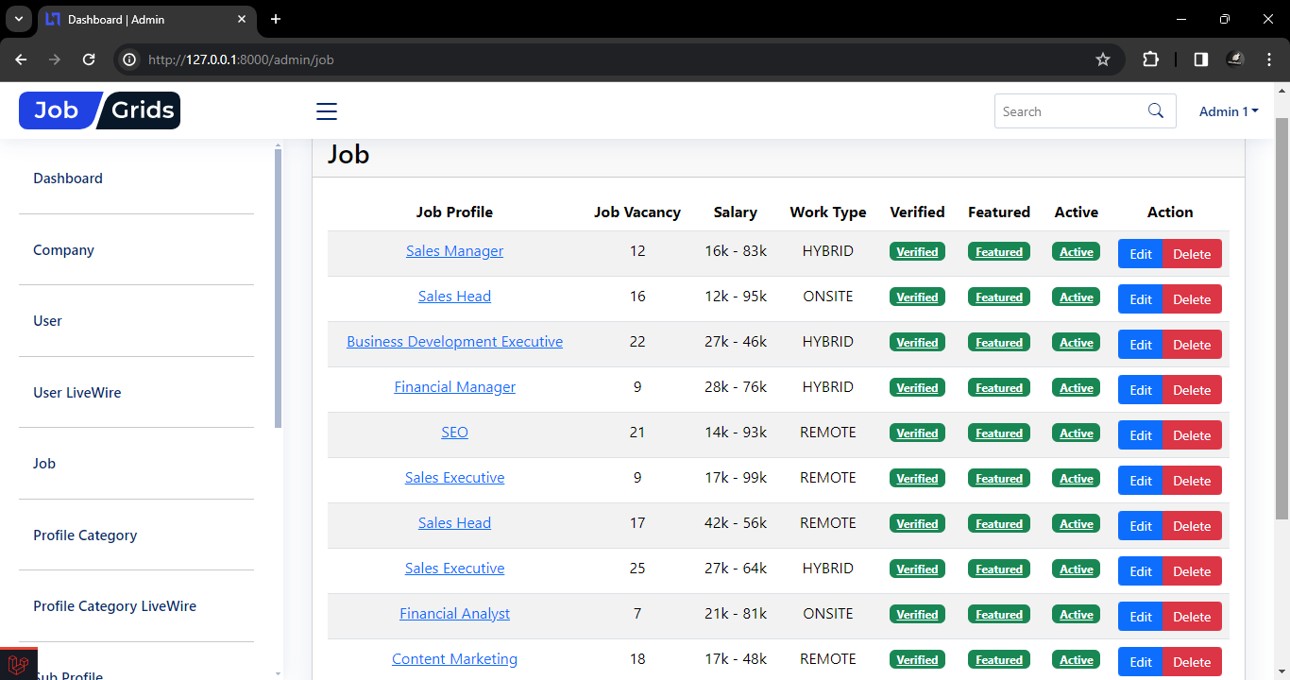
Screen Shots

Slide 30
System Testing
Testing and Implementation
System testing is a critical phase in the development lifecycle of the job portal project. It ensures that the entire system, including its components and functionalities, operates as intended before deployment to production.
Testing Methodology
Functional Testing: Verifying the functionality of each feature, such as user registration, job posting, job search, etc.,
Integration Testing: Testing the integration of individual components to ensure they function together as a cohesive system.
Performance Testing: Evaluating system performance under varying loads to ensure it can handle expected user traffic.

Slide 31
System Testing
Test Case Design
User Registration: Verify that users can register successfully with valid information.
Job Posting: Test that companies can post jobs with accurate details and required information fields.
Job Search: Ensure users can search for jobs using different criteria and obtain relevant results.
System Implementation Strategy
Test Environment Setup: Establish a dedicated testing environment mirroring the production environment to conduct testing without affecting live operations.
Test Plan Creation: Develop a comprehensive test plan outlining testing objectives, scope, resources, and timelines.

Slide 32
Conclusion
This document has presented a comprehensive overview of the Job Portal Website developed using Laravel/PHP and a MySQL database. The website caters to three user types: Users (job seekers), Companies (employers), and Admins

Slide 33
LEARNING DURING PROJECT WORK
Technical Skills
Gained proficiency in Laravel development framework, particularly in areas like routing, controllers, models, and database interactions using Eloquent.
Project Management
Enhanced skills in project planning, breaking down the development process into manageable tasks.
Soft Skills
Developed problem-solving abilities by encountering and resolving technical challenges throughout the development process.

Slide 34
BIBLIOGRAPHY
Online References
Laravel Documentation. Available online at: https://laravel.com/docs
GitHub - Version control platform. Available online at: https://github.com/
Offline References
Martin, Robert C. Clean Code: A Handbook of Agile Software Craftsmanship. Prentice Hall, 2008.
2. Gamma, Erich et al. Design Patterns: Elements of Reusable Object-Oriented Software. Addison-Wesley, 1994.
3. Fowler, Martin. Refactoring: Improving the Design of Existing Code. Addison-Wesley, 1999.

Slide 35
Thank You

